Slide 1
Cross-Platform Mobile Application Development with Xamarin
Module 3, Lesson 10:
Cross-Platform User Interfaces with Xamarin.Forms (Part 2)
Notes:
Images and excerpts from Xamarin Mobile Application Development by Dan Hermes, published by Apress
http://www.mobilecsharpcafe.com/xamarin-book/

Slide 2
Topics
Code reuse with Xamarin.Forms
Basics of Xamarin.Forms Development

Slide 3
Xamarin.Forms Concepts
These are key concepts in Xamarin.Forms development:
Development fundamentals of Xamarin.Forms
Navigation
ListView
State Management

Slide 4
Basic Xamarin.Forms Concepts II

Slide 5
Navigation
Maintains a list of screens (current and past)
Navigation Property | Description
PushAsync | Navigates to a page
PopAsync | Performs a “back” operation
PushModalAsync | Opens a modal page
PopModalAsync | Removes a modal page
Notes:
Notes:
Navigation object has other methods, like PopToRootAsync, which will wipe the navigation stack and return to the original Page
There are other methods to manipulate the stack, like RemovePage, which will remove a Page from the navigation stack, or InsertPageBefore, which will place a Page into the navigation stack
There are also properties on the Navigation object. Two to note are ModalStack and NavigationStack. These two properties return a collection of modal dialog Pages that have been added to the Navigation’s modal stack via PushModalAsync and a collection of Pages that have been added to the Navigation’s Page stack via PushAsync, respectively
References:
More information on Navigation: https://developer.xamarin.com/guides/xamarin-forms/getting-started/introduction-to-xamarin-forms/#Navigation

Slide 6
Navigation Patterns
Hierarchical
Modal
Drill-down list
Tabs
Navigation drawer
Notes:
Notes:
Cross-platform terms attributed in part to in part to Adam Kemp’s blog post, Navigation in Xamarin.Forms , and Mobile Design Pattern Gallery by Theresa Neil
Navigation Drawer (a left-to-right sliding menu usually triggered by the hamburger icon in the upper left hand part of the screen) is a common pattern but not covered in this lesson.

Slide 7

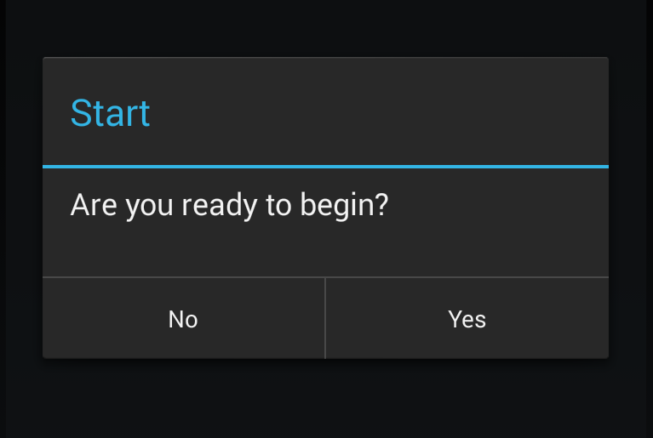
Hierarchical
Modal
Notes:
References:
Images from Xamarin Mobile Application Development by Dan Hermes http://amzn.to/1rowG7K

Slide 8
NavigationPage
public class App : Application {
{
public App()
{
MainPage = new NavigationPage(new HomePage());
}
}

Slide 9
Hierarchical Navigation using NavigationPage
Instantiate a NavigationPage and pass in a ContentPage
In the child page:
Set Title and Icon Properties
Navigation.PushAsync (new MyPage)
Navigation.PopAsync();

Slide 10
Full Screen Modal
Navigation.PushModalAsync( new nextPage());
Navigation.PopModalAsync();
Notes:
Notes:
PushModalAsync creates an interruptive full-screen page (nextPage) which overrides existing navigation stack.
PopModalSync will return to the previous stack.

Slide 11
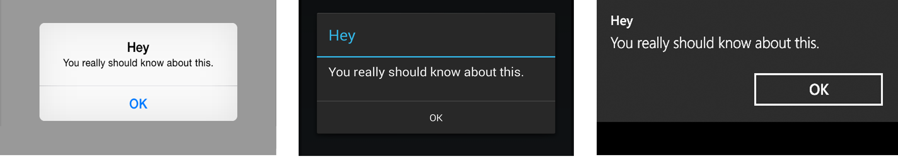
Modal Popup
Button button = new Button { Text = "Show Alert" };
button.Clicked += async (sender, e) =>
{
await DisplayAlert("Hey", "You really should know about this.", "OK");
};
Notes:
Notes:
The DisplayAlert method of the ContentPage displays a pop-up alert
This is typically used with async/await so execution will halt until the pop-up is cleared
References:
Images from Xamarin Mobile Application Development by Dan Hermes http://amzn.to/1rowG7K

Slide 12
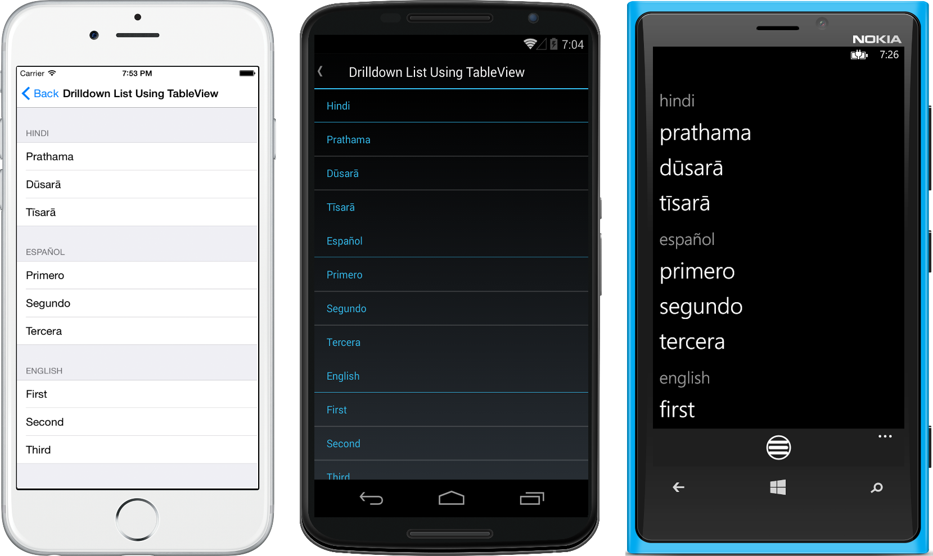
Drill-down List
Notes:
References:
Images from Xamarin Mobile Application Development by Dan Hermes http://amzn.to/1rowG7K

Slide 13
Drill-down Lists: NavigationPage
public class App : Application
{
public App()
{
MainPage = new NavigationPage(new DrilldownListViewByItem ());
}
}
Notes:
Notes:
Wrap ListView in a NavigationPage
More on ListViews soon

Slide 14
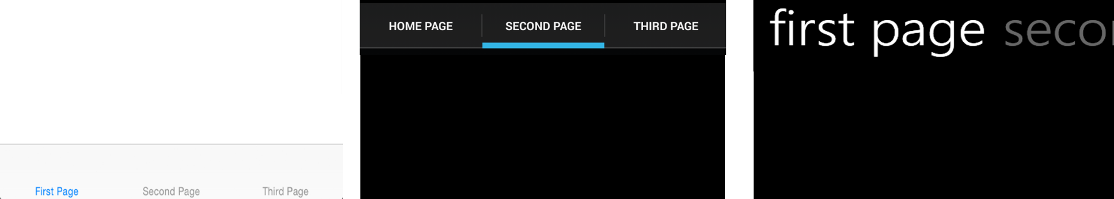
Tabs
class TabPage : TabbedPage
{
public TabPage()
{
this.Title = "Tabbed Page";
this.Children.Add (new homePage());
this.Children.Add (new secondPage());
this.Children.Add (new thirdPage());
}
}
Notes:
References:
Images from Xamarin Mobile Application Development by Dan Hermes http://amzn.to/1rowG7K

Slide 15
Xamarin.Forms Navigation
Navigation Pattern | Xamarin.Forms Class
Hierarchical | NavigationPage
Modal | NavigationPage, alerts, and ActionSheets
Drill-down lists | NavigationPage, ListView, and TableView
Navigation drawer | MasterDetailPage
Tabs | TabbedPage
Notes:
Notes:
Summary of Navigation

Slide 16
Gestures
Unified way to handle common user interaction with controls
User Interaction | Description
TapGestureRecognizer | detects and handles taps on controls
PinchGestureRecognizer | detects and handles pinches on controls
PanGestureRecognizer | detects and handles dragging on controls
Notes:
Notes:
The separate devices sometimes handle gestures dramatically differently, even though the UI concept is extremely similar across device types
The GestureRecognizer class abstracts the details of handling some common user interaction
TapGestureRecognizer will detect a tap on a control and provide a way to handle a tap action from a user on a control
PinchGestureRecognizer will detect a pinch – or zoom – on a control from a user and provide a way to handle a pinch action from a user on a control
PanGestureRecognizer will detect a pan – or drag – on a control and provide a way to handle a pan action from a user on a control

Slide 17
TapGestureRecognizer
var tapGestureRecognizer = new TapGestureRecognizer();
tapGestureRecognizer.Tapped += (s, e) => {
//Tap handler goes here
};
image.GestureRecognizers.Add(tapGestureRecognizer);
Notes:
Notes:
TapGestureRecognizer example.
Instantiate the Image control first.

Slide 18
ListView
The list view is the new grid view (on mobile apps)
Bind to an array or data model
Scrollable and selectable
Most importantly, they need to be fast (performance)
Notes:
Notes:
Limited real estate on mobile screens encourages the use of list views instead of the usual multi-column grid views.
Lists in Xamarin.Forms are created using the ListView control bound to an array or data model. The Xamarin.
Forms ListView class provides a scrollable, selectable list. List rows are customizable using layouts, images, and views such as buttons. ListView supports grouping, headers, footers, jump lists, and pull-to-refresh.
Deleting and applying operations to list rows are supported using Context Actions.
Performance is key with list views. Performance techniques outside the scope of this lesson. Cell reuse is automatic in Xamarin.Forms.
References:
https://developer.xamarin.com/guides/xamarin-forms/user-interface/listview/performance/

Slide 19
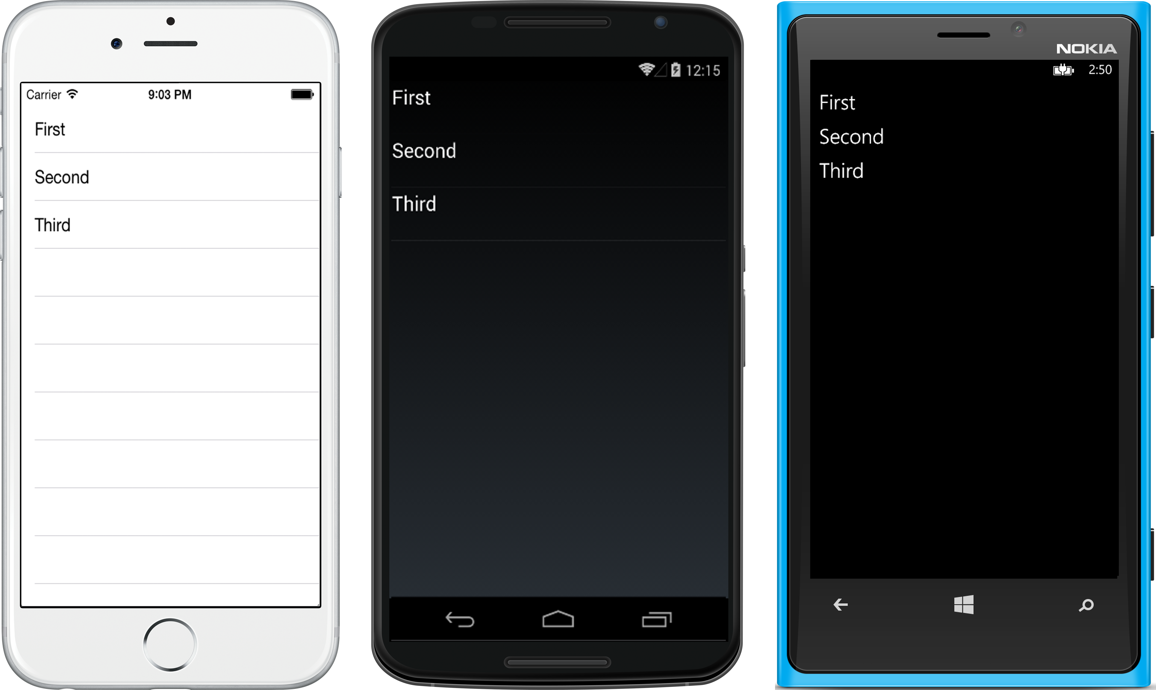
ListView
Notes:
References:
Images from Xamarin Mobile Application Development by Dan Hermes http://amzn.to/1rowG7K

Slide 20
ListView from an Array of Strings
class ListViewStrings : ContentPage
{
public ListViewStrings()
{
ListView listView = new ListView();
List<String> items = new List<String>() {"First","Second","Third"};
listView.ItemsSource = items;
this.Content = listView;
}
}
Notes:
Notes:
The simplest ListView implementation is binding to a List of Strings.
Instantiate a ListView class on your page and point it to a data source using the ItemsSource property, in this case a List of Strings. Using the default layout, each item in a ListView will be a single cell using the TextCell template displaying a single line of text.

Slide 21
ListView ItemTapped
listView.ItemTapped += async (sender, e) =>
{
await DisplayAlert("Tapped", e.Item.ToString() + " was selected.", "OK");
((ListView)sender).SelectedItem = null;
};
Notes:
Notes:
There are two events for use in item selection: ItemTapped and ItemSelected. Both can happen when a user taps a cell in the ListView. The difference between them is apparent when a list permits more than just tapping and items can be selected and unselected. In simple lists where there is no unselection of rows (like the example here), there is little difference between them.
ItemTapped is the simplest. It fires as a motion event when a list row is clicked.
Instantiate a ListView class on your page and point it to a data source using the ItemsSource property, in this case a List of Strings. Using the default layout, each item in a ListView will be a single cell using the TextCell template displaying a single line of text.

Slide 22
ListView Using Data Binding
public class ListItem {
public string Title { get; set; }
public string Description { get; set; }
}
Notes:
Notes:
Binding ListView to a data model is made easy in Xamarin.Forms through the use of ListView's built-in adapter called ItemTemplate.
Prepare your data model class and assign it to the ListView.ItemsSource property.
Then bind each property of your model to the list using the ItemTemplate.SetBinding method.
Create a data model, or custom class, containing the list items. Call it ListItem.

Slide 23
ListView Using Data Binding
var listView = new ListView();
listView.ItemsSource = new ListItem[] {
new ListItem {Title = "First", Description="1st item"},
new ListItem {Title = "Second", Description="2nd item"},
new ListItem {Title = "Third", Description="3rd item"}
};
listView.ItemTemplate = new DataTemplate(typeof(TextCell));
listView.ItemTemplate.SetBinding(TextCell.TextProperty, "Title");
listView.ItemTemplate.SetBinding(TextCell.DetailProperty, "Description");
Content = listView;
Notes:
Notes:
The simplest ListView implementation is binding to a List of Strings.
Instantiate a ListView class on your page and point it to a data source using the ItemsSource property, in this case a List of Strings.
Using the default layout, each item in a ListView will be a single cell using the TextCell template displaying a single line of text.

Slide 24
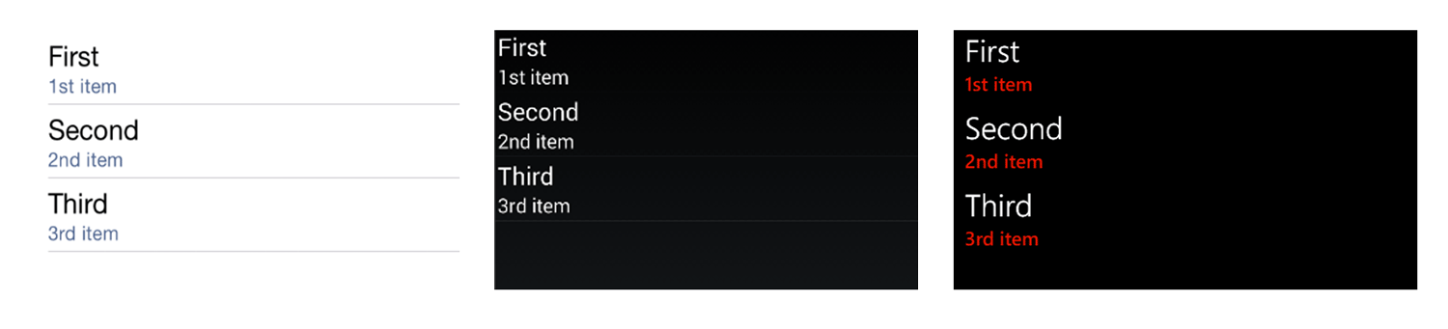
ListView Using Data Binding
Notes:
Notes:
Lists in Xamarin.Forms are created using the ListView control bound to an array or data model. The Xamarin.
Forms ListView class provides a scrollable, selectable list. List rows are customizable using layouts, images, and views such as buttons. ListView supports grouping, headers, footers, jump lists, and pull-to-refresh.
Deleting and applying operations to list rows are supported using Context Actions.
References:
Images from Xamarin Mobile Application Development by Dan Hermes http://amzn.to/1rowG7K

Slide 25
ListView ItemTapped
listView.ItemTapped += async (sender, e) =>
{
ListItem item = (ListItem)e.Item;
await DisplayAlert("Tapped", item.Title.ToString() + " was selected.", "OK");
((ListView)sender).SelectedItem = null;
};
Notes:
Notes:
When handling the item selection, remember to use the data model.

Slide 26
Cell
Describes how an item in a list should be displayed
Subtypes | Description
EntryCell | contains a label and a textbox
SwitchCell | contains a label and an on/off switch
TextCell | contains a primary label and a secondary label
ImageCell | a TextCell that also has an image
Notes:
Notes:
Cells are used by ListView and TableView Controls
ListViews are used to display lists of things. Maybe titles or names of items. They frequently are then clicked on to display a child page with all the fine details of the item displayed in a subpage
TableViews are similar to ListViews, but frequently don’t have the same template for each item and have to have their child items added manually instead of just setting the ItemsSource property, as one can do in a ListView
References:
ListView reference: https://developer.xamarin.com/guides/xamarin-forms/user-interface/listview/
TableView reference: https://developer.xamarin.com/guides/xamarin-forms/user-interface/tableview/

Slide 27
State Management
Maintain the illusion of continuity during navigation
Sharing of data between screens
Pass variables directly into an instantiated ContentPage
Notes:
Notes:
State helps us maintain the illusion of consistency and continuity while the user navigates among screens, through the sharing of data on those screens. We’re no longer in the world of query strings, cookies, and Session variables, but we must still maintain state in mobile apps.
Most variables are scoped to a particular screen, so state management usually involves the explicit passing of data back and forth between screens.
Parameter passing between screens is the encouraged method of state management on all mobile platforms, to minimize the risk of memory abuse and to maximize app performance.
Xamarin.Forms allows us to pass parameters into a ContentPage constructor.
The static global class is a C# implementation of the Singleton pattern. It is available on all platforms but must be used with caution; be mindful of mobile-device memory limitations. Disk persistence is built into Xamarin.Forms by using the Application objects’ Properties, a dictionary using ID/object pairs.

Slide 28
Passing Data Between Pages
Pass data values directly into your page’s constructor
Constructor params is the most common and safest way
Here are other ways to pass data between pages:
Static data instance (global) available to all pages
Static properties on the Application object
Static Properties dictionary to persist key/ value pairs to disk
Application.Current.Properties["id"] = 12345;
Notes:
References:
Activities: http://developer.android.com/reference/android/app/Activity.html

Slide 29
Pass Data into A Page’s Constructor
// Define a detail page with a ListItem class as a constructor
// parameter:
class DetailPage : ContentPage
{
public DetailPage(ListItem item)
…
// Then pass instances of the ListItem class directly into
// DetailPage:
Navigation.PushAsync (new detailPage(item));

Slide 30
Summary
In this lesson, you have learned:
Development fundamentals of Xamarin.Forms
Navigation
ListView
State Management
Notes:
Notes:
The Module 3 Lesson 10 Lab should be completed at this time:
https://github.com/MSFTImagine/computerscience/tree/master/Complimentary%20Course%20Content/Module3/Labs

